Slide 1
Just Culture in DevOps
By Colton Stone
Assignment 8.2
July 19, 2026

Slide 2
What is Just Culture?
In DevOps ‘Just Culture’ refers to an ideology where there is mutual accountability among team members for the development of the products that they create within their workspace. The main purpose behind this idea is to promote synergy among team members to help one another create a healthy work environment and produce the best possible service for their customers
(Hall, n.d.).

Slide 3
The Benefits of this Practice
Under this mindset both a team’s developers and operators are taught that their development is a learning process where the issues that they encounter during the building of a project will be documented for future learning purposes, and thus helps employees to feel more confident that their mistakes will not be used against them, but instead, will be used as a lesson to educate both themselves and future workers on how to avoid future pitfalls in software development
(Hall, n.d.).

Slide 4
The Benefits of this Practice (Cont.)
Some the advantages gained from this practice include:
Higher satisfaction rates among both customers and company employees
Better company performance levels and faster regular software releases or updates
A more robust correspondence system where everyone can receive faster feedback when needed and communicate more efficiently thus reducing potential issues caused by misunderstandings
(Hall, n.d.; Fenton, 2025).

Slide 5
Statistical Information
According to Tom Hall, an associate and writer on ‘Atlassian.com’ statistics show that:
Sixty-one percent (61%) of organizations who make use of DevOps have reported that they distribute higher quality products
Forty-nine percent (49%) release their products faster than they did with their previous format
Seventy-eight percent (78%) who have intergraded the tools into their workflow have reported to have improved their skills forty-eight percent (48%) earned a pay raise
(Hall, n.d.).

Slide 6


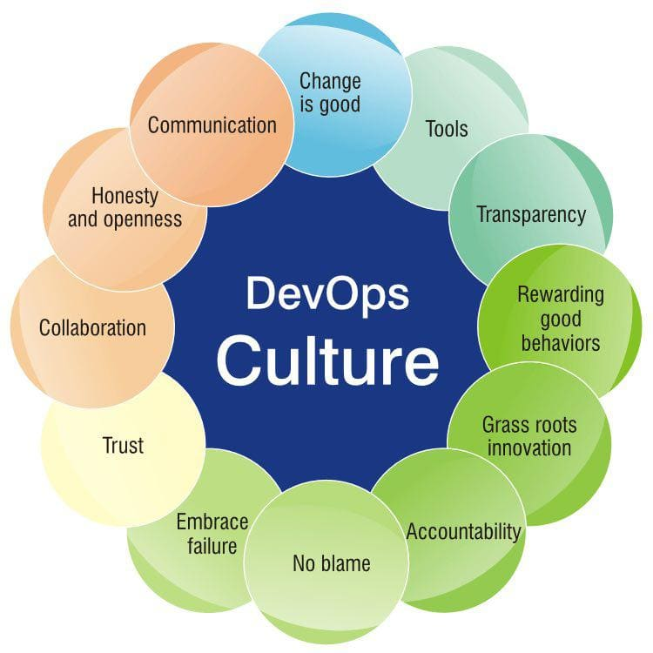
The Principles of DevOps Culture
As you see in this image these are the ideals which are meant to make of the culture behind this idea, where a team has an open and judgement free learning environment for its employees
(Fedak, 2023).

Slide 7
The Difficulties of this Practice
However, it must be understood that implementing this practice can be a challenging task especially in such cases when it involves changing the already established culture in a work environment. This also applies to adding DevOps tools to a system as well since while such tools will likely be more advanced than the ones that the team are already using, a sudden change can be difficult for some people to adapt to especially if they have been using the now replaced software for years prior
However, as Vladimir Fedak, the CEO of ‘IT Svit.com’ empathizes in his article, the DevOps approach is now only considered the most optimal way for software companies, but it has now gradually shifted to become the necessary method for companies to be able to compete with their rivals in today’s market
(Hall, n.d; Fedak, 2023).

Slide 8
Citations
Hall, T. (n.d.).
What is DevOps Culture?
https://www.atlassian.com/devops/what-is-devops/devops-culture
Fenton, S. (2025, September 1).
4 pillars of DevOps Culture and its macro and micro benefits
https://octopus.com/devops/culture/

Slide 9
Citations (Cont.)
Fedak, V. (2023, April 18).
DevOps Culture in 2023: A Huge Step for Mankind https://itsvit.com/blog/devops-culture-huge-step-mankind/
Kim, Gene, et al. The DevOps Handbook, 2nd edition. IT Revolution, 2021.

